Slide 1

Session 20 (of 24) JDBC
PGR112 Objektorientert programmering
Yuan Lin / yuan.lin@kristiania.no

Slide 2
Today’s Main Goal
Prepared Statement
Callable Statement
Stored procedure
Stored functions
Type of Parameters: IN, OUT, INOUT
call keyword syntax
Transactions, commitment, rollback
SQL injections

Slide 3
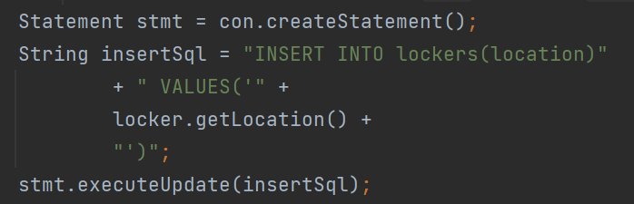
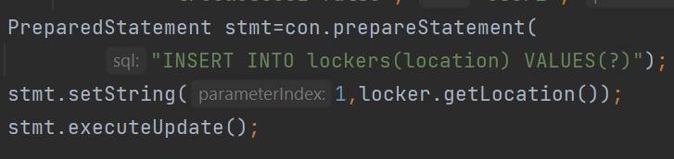
Prepared statement
Let’s compare below two pieces of code. What is the difference here?
As you can see, for PreparedStatement(), we are passing parameter (?) for the values. Its value will be set by calling the setter methods of PreparedStatement.
Why use PreparedStatement?
Efficiency… the same statement can be used repeatedly without re-compiling.
Security…it can reduce or eliminate SQL injection attacks. (We will show later)

Slide 4
Prepared Statement
Important methods of PreparedStatement interface
setInt, setString, setFloat, setDouble
executeUpdate used for createm drop, insert, delete
executeQuery used to execute the select query and return ResultSet
Only IN parameter is allowed in PreparedStatement. IN menas input parameter to the SQL statement. setXXX() methods are used to bind values.
Try-with-resource will automatically close PreparedStatement object.
A code walk-around

Slide 5
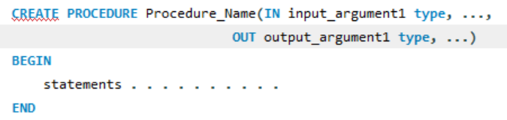
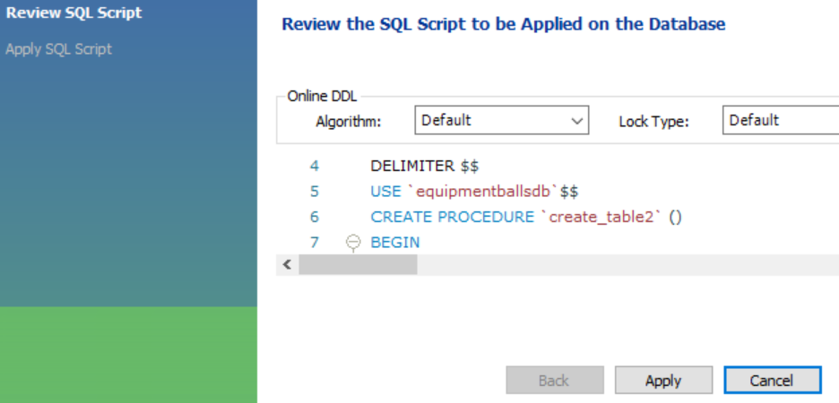
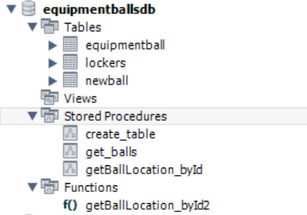
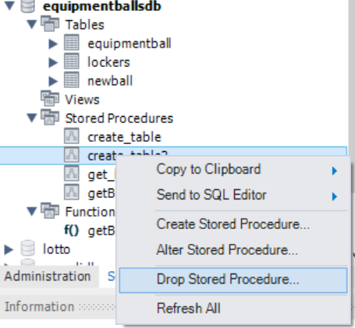
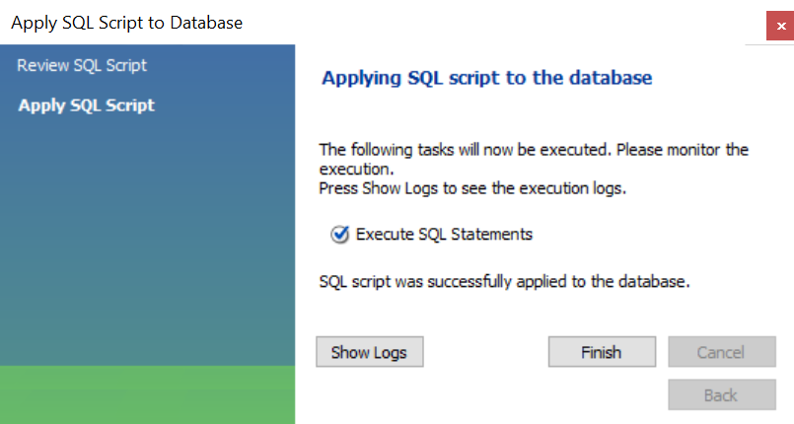
Callable Statement
What is stored procedures in database?
A stored procedure in SQL is a group of SQL statements that are stored together in a database.
You can create stored procedures, or drop procedures from MySQL workbench.

Slide 6
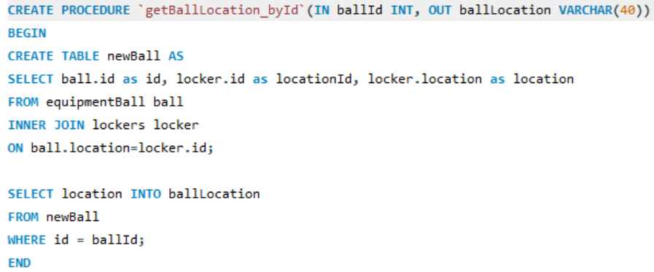
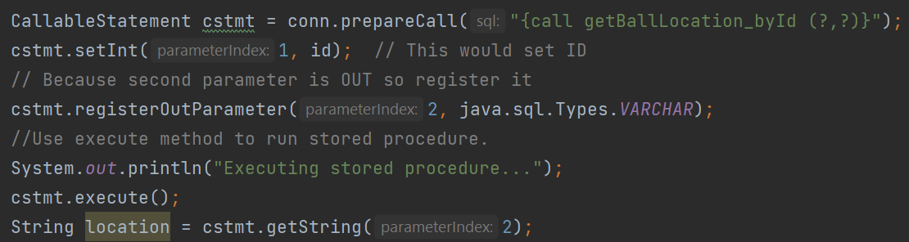
Callable Statement
A CallableStatement object in JDBC is used to execute a call to a database stored procedure.
Three types of parameters exist in CallableStatement – IN, OUT, INOUT.
IN: input parameter to the SQL statement. setXXX() methods are used to bind values.
OUT: output parameter supplied by the SQL statement. getXXX() methods are used to retriev values.
INOUT: both input and output. setXXX() methods are used to bind values. And getXXX() are used to retrieve values.
CallableStatement.registerOutParameter(index, type) must be used for OUT.
Try-with-resource will automatically close CallableStatement object.

Slide 7
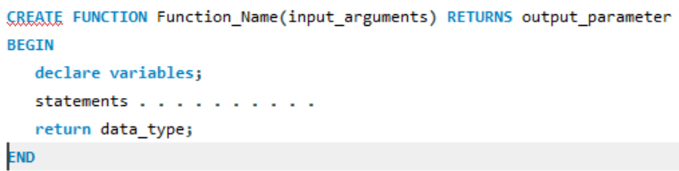
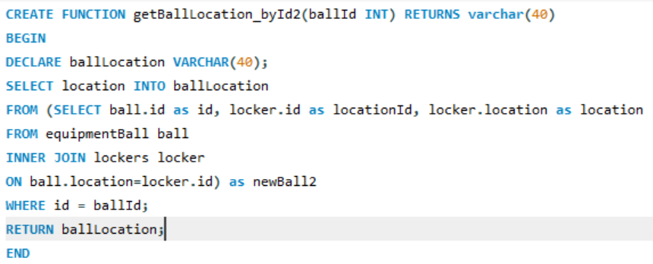
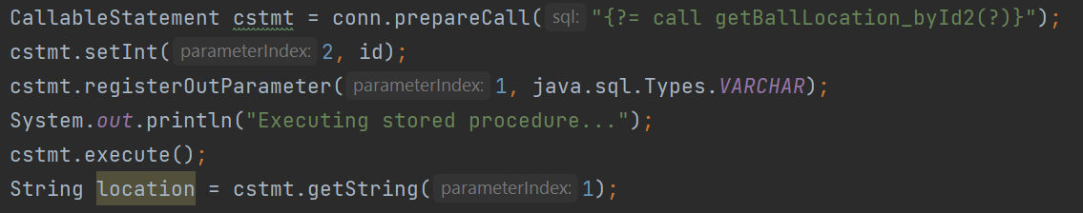
Callable Statement
You can also create functions in a database and store them.
The syntax of creating a function is shown as the code on the right.
CallableStatement supports stored functions.

Slide 8
Callable Statement
Following is the query to call a function from JDBC:
{? = call my_func(?,?)}
Following is the query to call a procedur from JDBC:
{call my_procedure(?,?)}

Slide 9
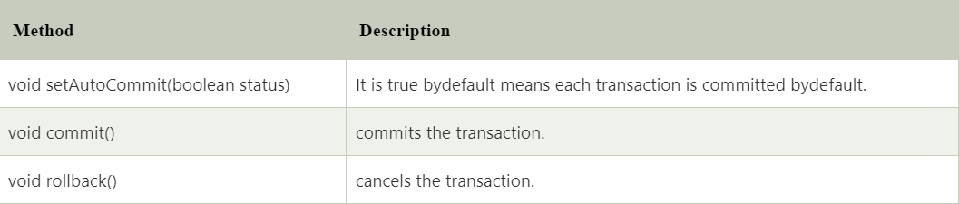
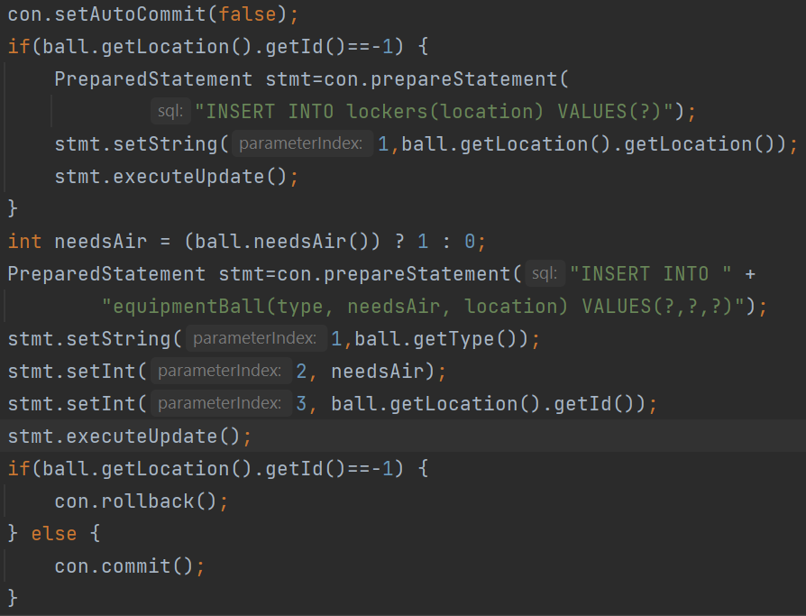
Transactions, Commitment, Rollback
What is transaction?
A transaction represents a single unit of work.
What is ACID properties? Atomicity, Consistency, Isolation, Durability.
Transactions are committed automatically by default.
But we can set auto-commit to false and commit transactions ourselves.
By doing so, we can rollback.
Rollback is executed not just when exceptions happen, but when certain conditions are met.
In JDBC, connection interface provides methods to manage transaction.

Slide 10
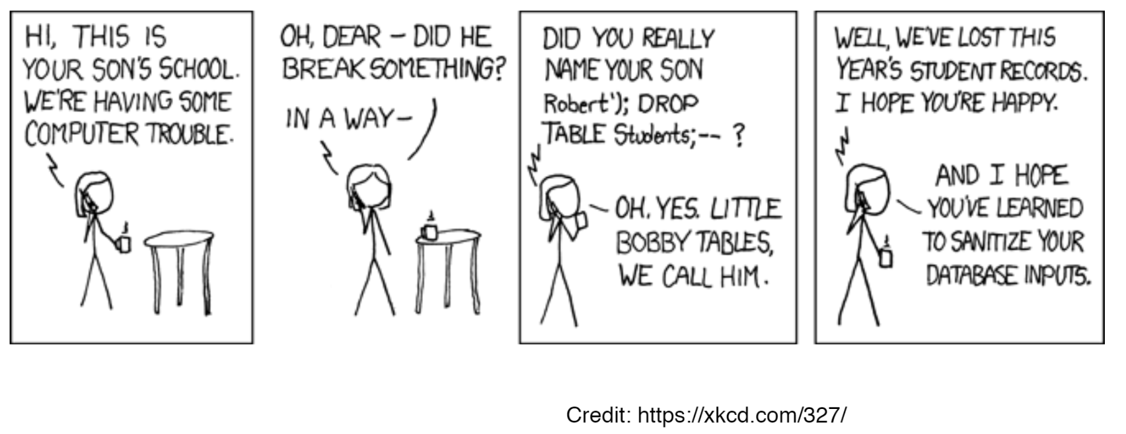
SQL Injection

Slide 11
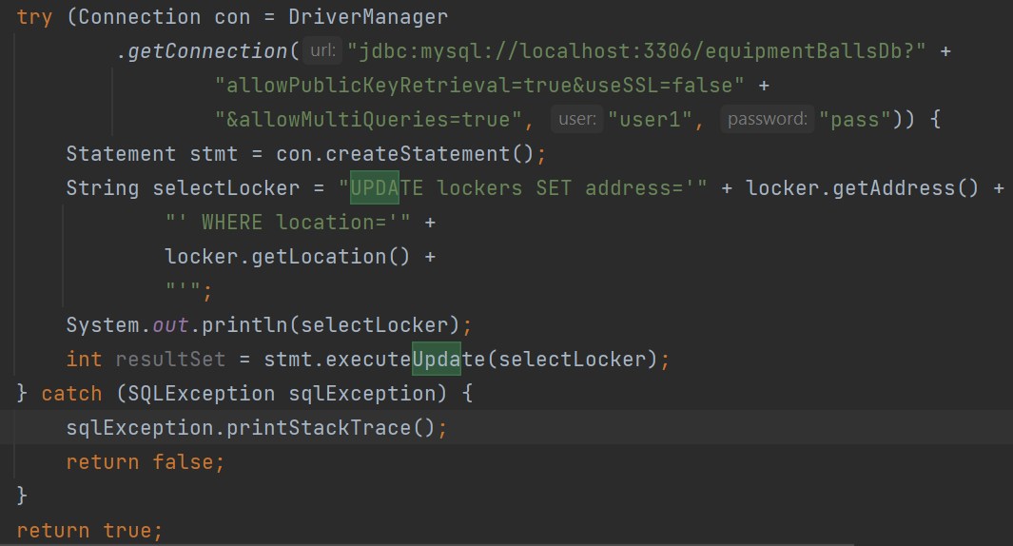
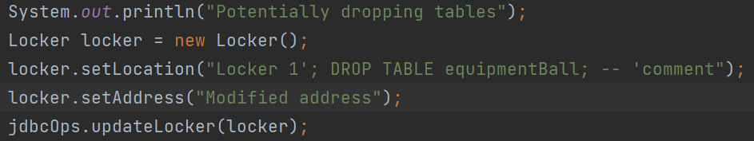
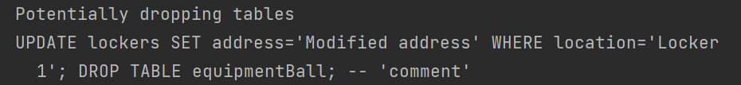
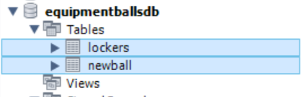
SQL Injection
SQL injection is a code injection technique that might destroy your database.
SQL injection is one of the most common web hacking techniques.
SQL injection is the placement of malicious code in SQL statements, via web page input.
There is a potential danger of using user input in SQL statements
SQL injection based on 1=1 is always true
SQL injection based on ““=”” is always true
SQL injection based on batched SQL statements (allowMultiQueries=true when establishing connection) are vulnerable to malicious code.

Slide 12
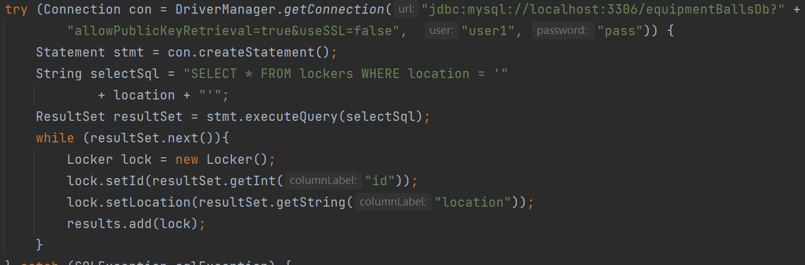
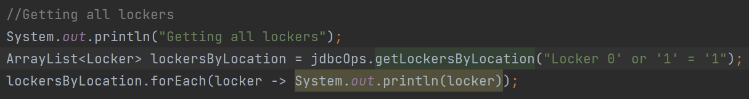
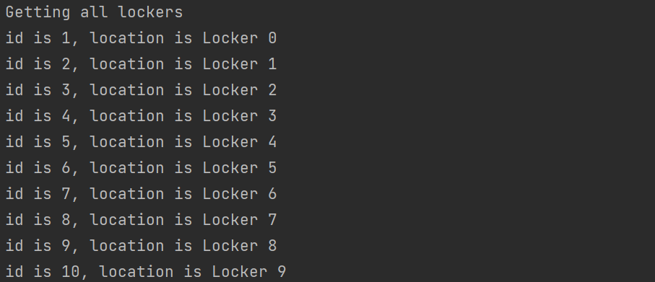
SQL Injection
More examples…

Slide 13
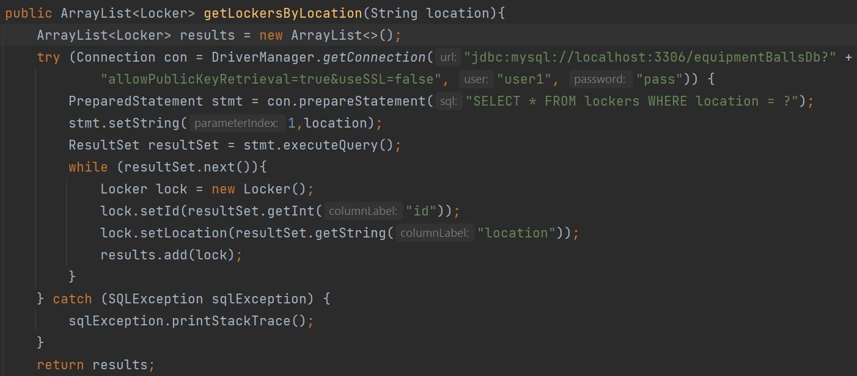
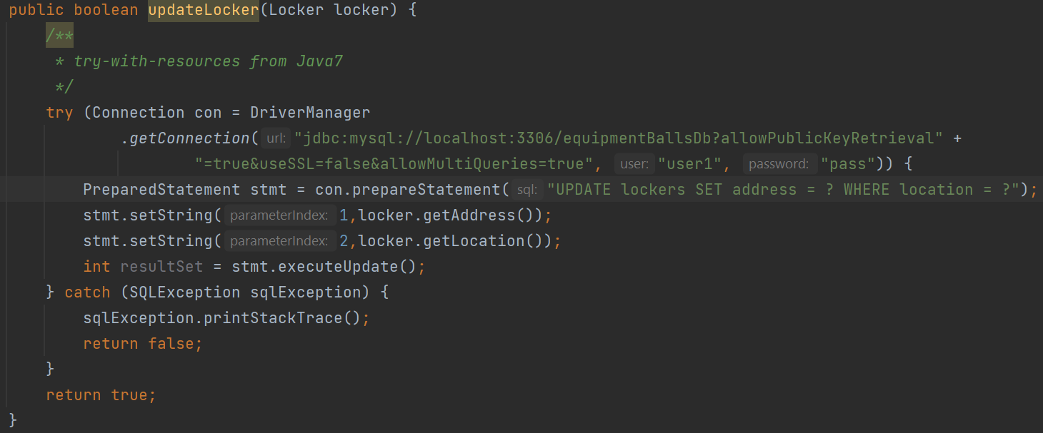
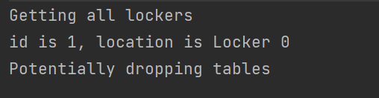
How to prevent SQL injection?
Using prepared statements in our queries whenever we need to insert a user-supplied value.
And more techniques..
A whitelist fgor user data sanitation
Server side input data validation, etc
We will exploit more in future lectures!

Slide 14
Before we end
You know better about PreparedStatement
You know better about CallableStatement
You know better about transactions, committment, and rollback
You know bether about SQL injection
You know some basic preventing techniques against SQL injection

